Slide 1


GIS Application for monitoring of separated waste in Rajec (town) by smart technology.
Author: Peter Rendek
The University of Žilina
Faculty of Management Science & Informatics, Department of Mathematical Methods and Operations Research
June 2021

Slide 2
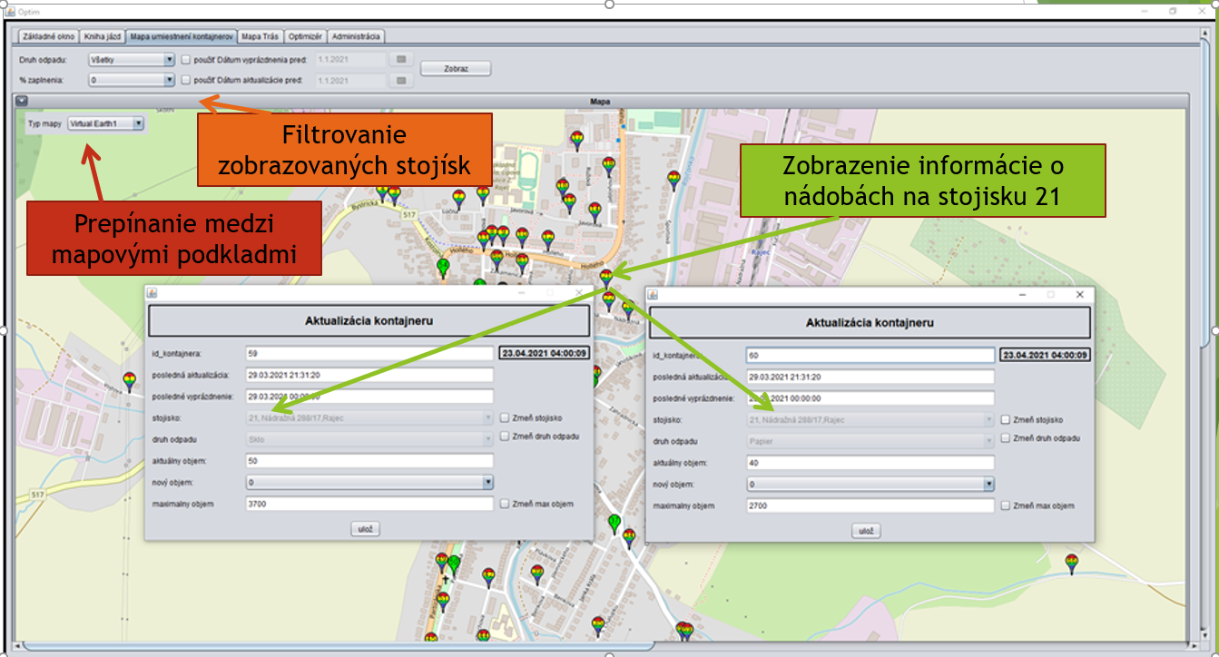
Analýza aktuálnej situácie v Rajci
Počet obyvateľov: 5777, Rozloha: 31,46km²
Komunálny odpad, sklo, plast, papier, kovové obaly, textil, olej
65 stojísk:
Sklo: 68
Plast: 36
Papier: 46
Kov. obaly: 17
Textil: 11
Olej: 2

Slide 3
Project requirements
Monitoring of the filling of collection containers (SMS gateway, Sensoneo sensor)
Optimization of collection routes
Optimization of collection places
Planning and management of collection drives
Waste management statistics

Slide 4




Used tools and technologies
QGIS, Open Street Map
MySQL, MySQL Workbench, Toad Data Modeler
Java, Netbeans, JxMapViewer2

Slide 5
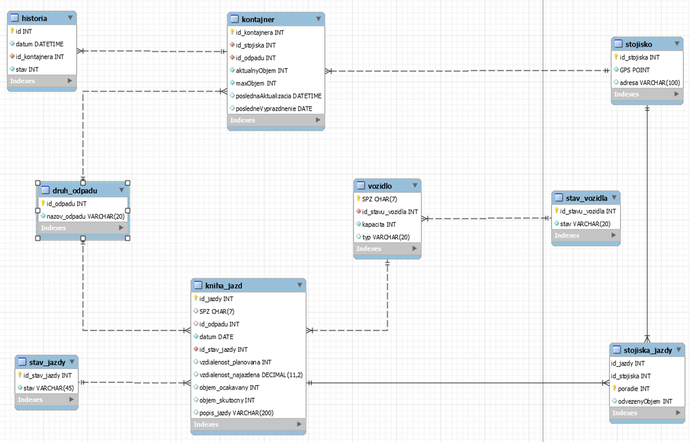
Database model
history
garbage can
collection place
has
has
is type
type of waste
vehicle
car status
has status
has place
collection route
Has/had collection drives
is type
collection places
route status
has status
has place

Slide 6
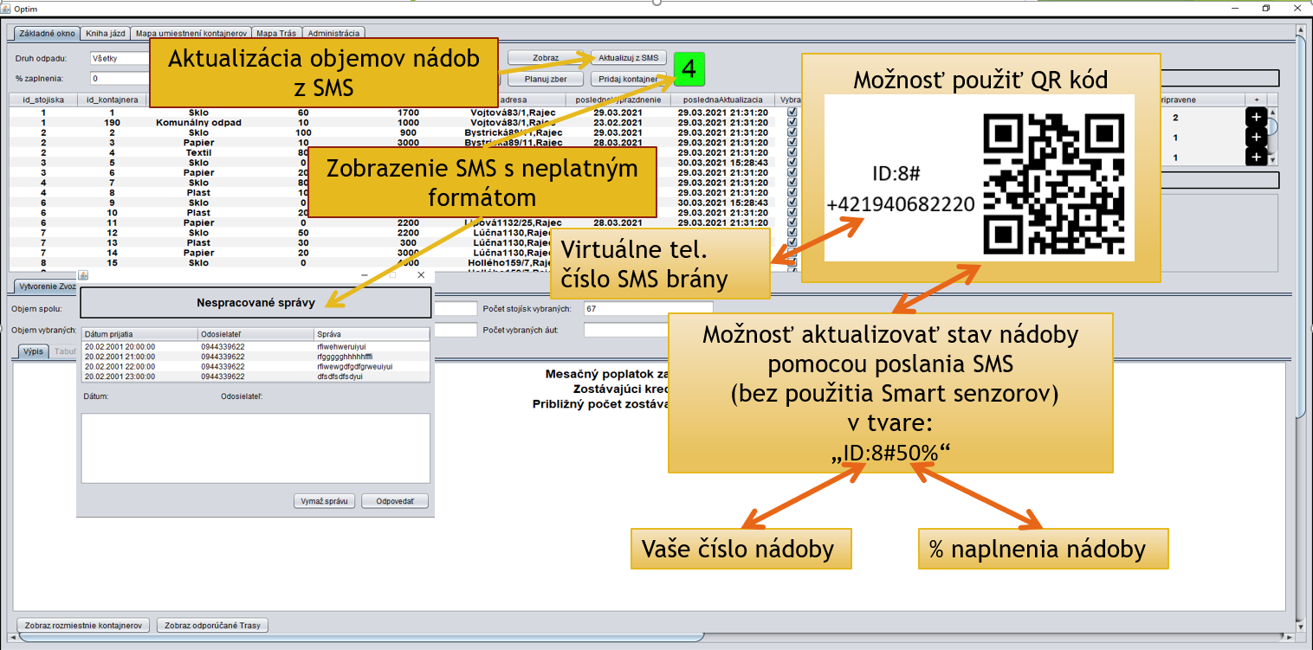


Monitoring of the filling of collection containers (SMS gateway, Sensoneo sensor)
Update of the filling of collection
cans from the sms gateway
The possibility of using a QR code
Messenger - displays sms messages
with incorrect format
Virtual phone number
for SMS gateway
Possibility to update the filling of the garbage can via sending an SMS (without the use of a smart sensor)
SMS format:
garbage can identifier
% filling of garbage can

Slide 7
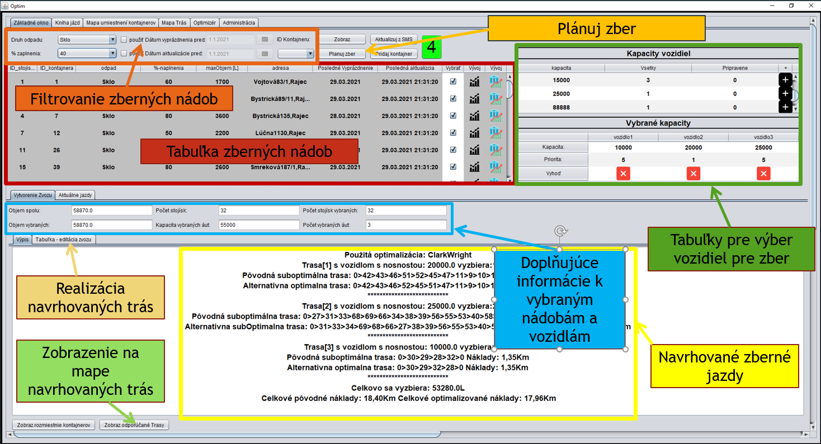
Optimization of collection routes
Plan the collection
.......filters.........
Table of collection places
table for vehicle
....selection....
information about
collection points
and vehicles
editation of...
proposed routes...
visualization of
..... routes.....
proposal of collection ........ routes........

Slide 8
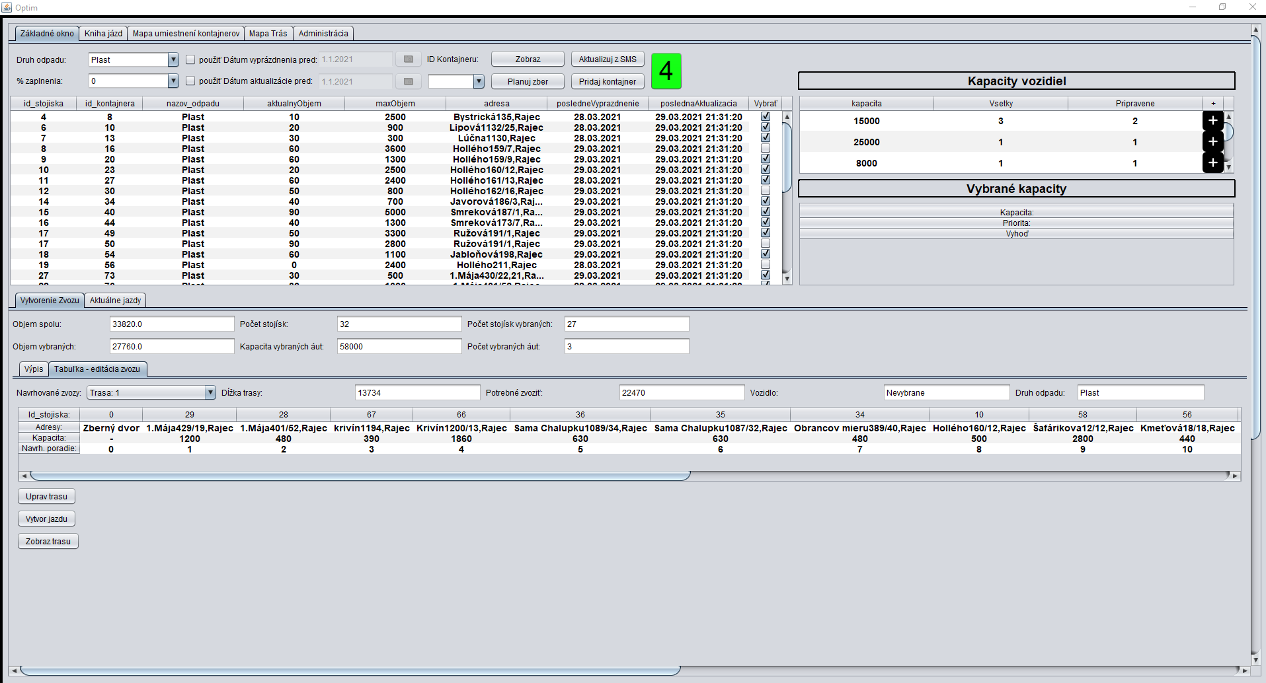
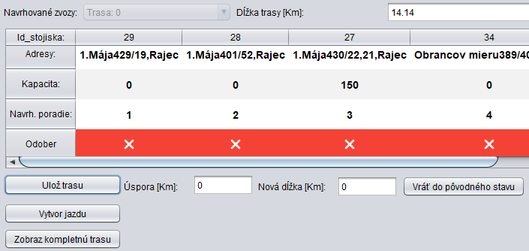
Optimization of collection routes – Editation route
turn on/off editation
Switching between displayed routes
Information about route
Using "drag and drop" for the column header, it is possible to change the order of collection places in route.
Display of extension / savings compared to the proposed route
Route execution

Slide 9
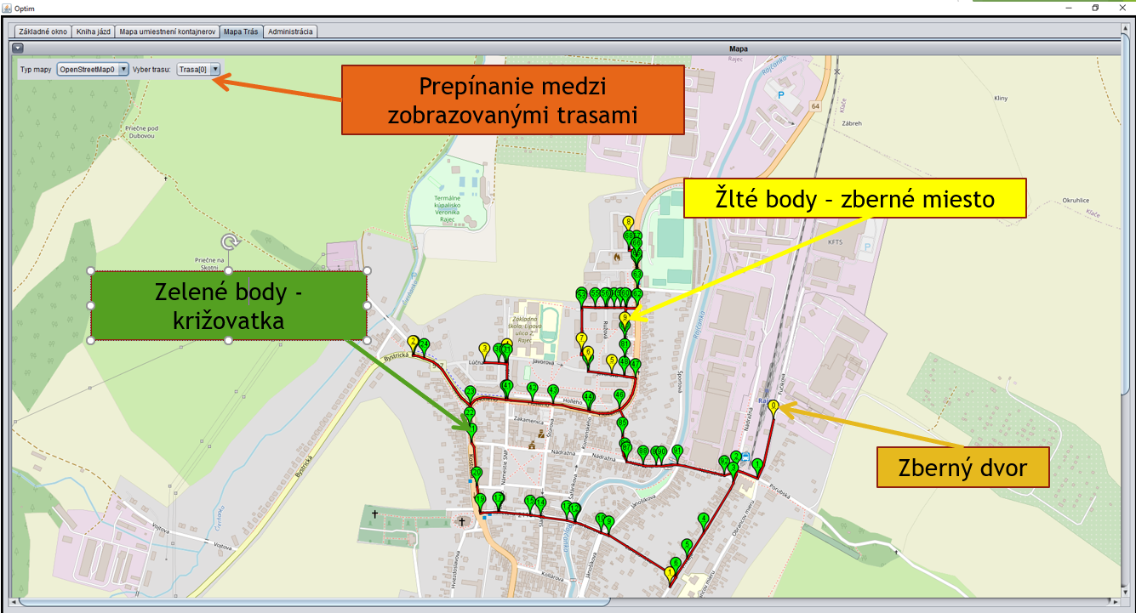
Optimization of collection drives - visualization
yellow point - collection place
green point –
crossroad
garbage yard

Slide 10
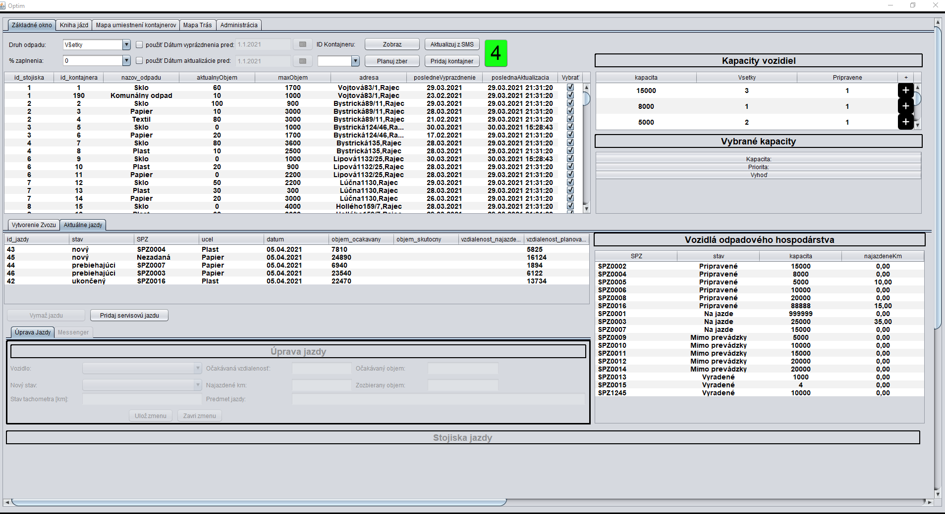
Management of planned and current routes
After clicking on the selected route, the route management becomes available
Vehicles park:
Update information about
vehicle
Add a new vehicle
Table of current routes
Creating a service route, that is not related to garbage collection

Slide 11
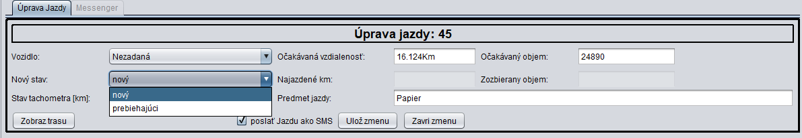
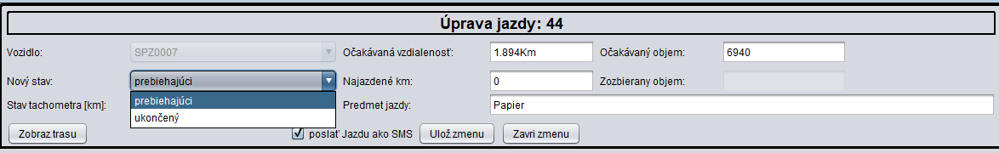
Management of route – route status „nový“ (new)
Select the vehicle that will make the route
Saving the change, if you have set the status to „ prebiehajúci (in progress)", the application will ask you if you want to send an SMS command to the worker who will make the colection
By setting the status to „prebiehajúci (in progress) “and saving, collection begins and the selected vehicle is set to "Na jazde (On the move)"
Management of route – route status „prebiehajúci in (progress)“
By setting the status, „ ukončený (completed)" and saving, the collection is finished and the selected vehicle will be set to „ Pripravené (Ready)".
Change confirmation

Slide 12
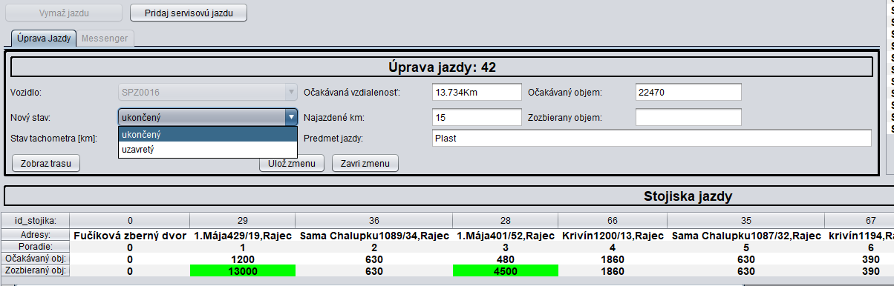
Management of route – route status „ukončený (finished)“
Entering the amount of waste that was collected during the route
By setting the status to "uzavretý (closed)" and saving, you remove the ride from the list of current routes and save it to the history
Entering the amount of waste that was collected at collecting place

Slide 13
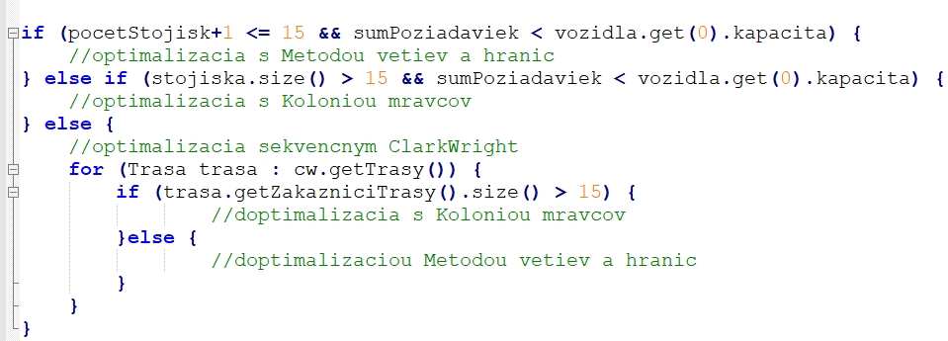
Optimalizácia zberných trás – výber algoritmu
count of collection places
amount of waste
vehicle
optimization by the method of branch and bound
amount of waste
vehicle
optimization of ACO - ant colony
necessary to use multiple rides
optimization by the sequential CartWright algorithm
reoptimize the proposed rides
optimization by the method of branch and bound
optimization by the method of branch and bound

Slide 14
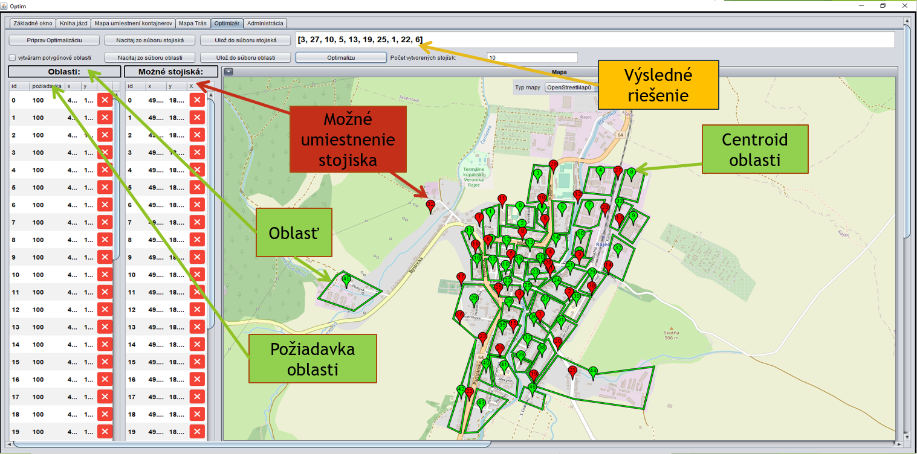
Optimization of collection places
solution
possible location
for collection place
controid of
the area
area
area....
requirement

Slide 15
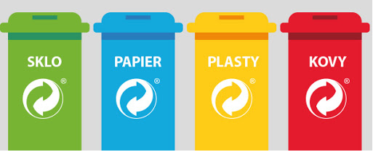
Ďakujem za pozornosť !
Separovanie nás stojí len čas, keďže za triedený odpad sa neplatí.
Platí sa len za odpad, ktorý končí na skládke.
14.6.2021
Vypracoval: Bc. Peter Rendek
Vedúci práce: doc. Ing. Peter Márton, PhD., KMMOA, UNIZA

Slide 16

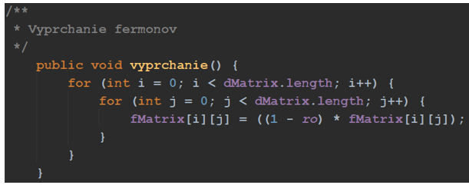
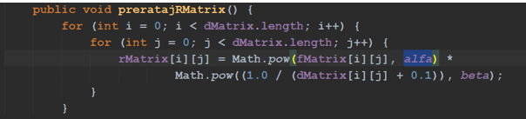
Otázky od oponenta
Bola aplikácia nasadená v reálnej praxi? Ak áno, aké sú na aplikáciu ohlasy?
Na str. 20 diplomant spomína v texte práce ako jednu z metód riešenia úlohy TSP metódu Backtracking. O akú metódu sa jedná?
V kapitole 3.3.3 sú uvedené parametre pre metódu ACO. Akým spôsobom boli tieto hodnoty nastavené?

Slide 17
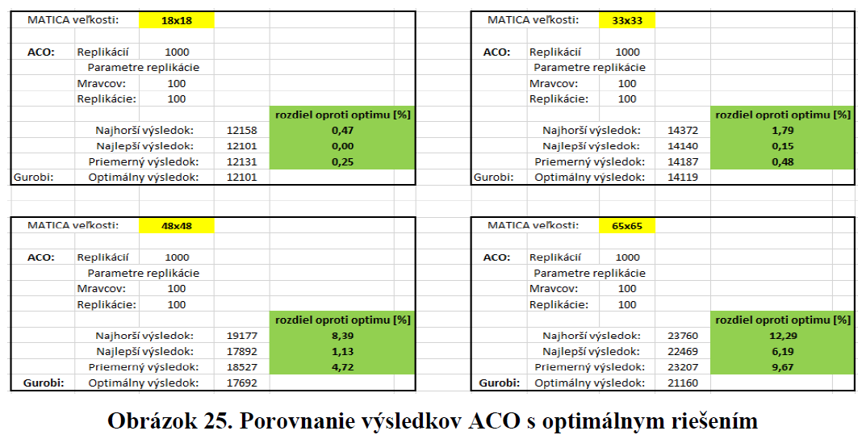
Otázky od oponenta
Na str. 50 sa píše, že diplomant ladil parametre algoritmu ACO. Bolo by vhodné uviesť’, akým spôsobom boli parametre ladené.

Slide 18
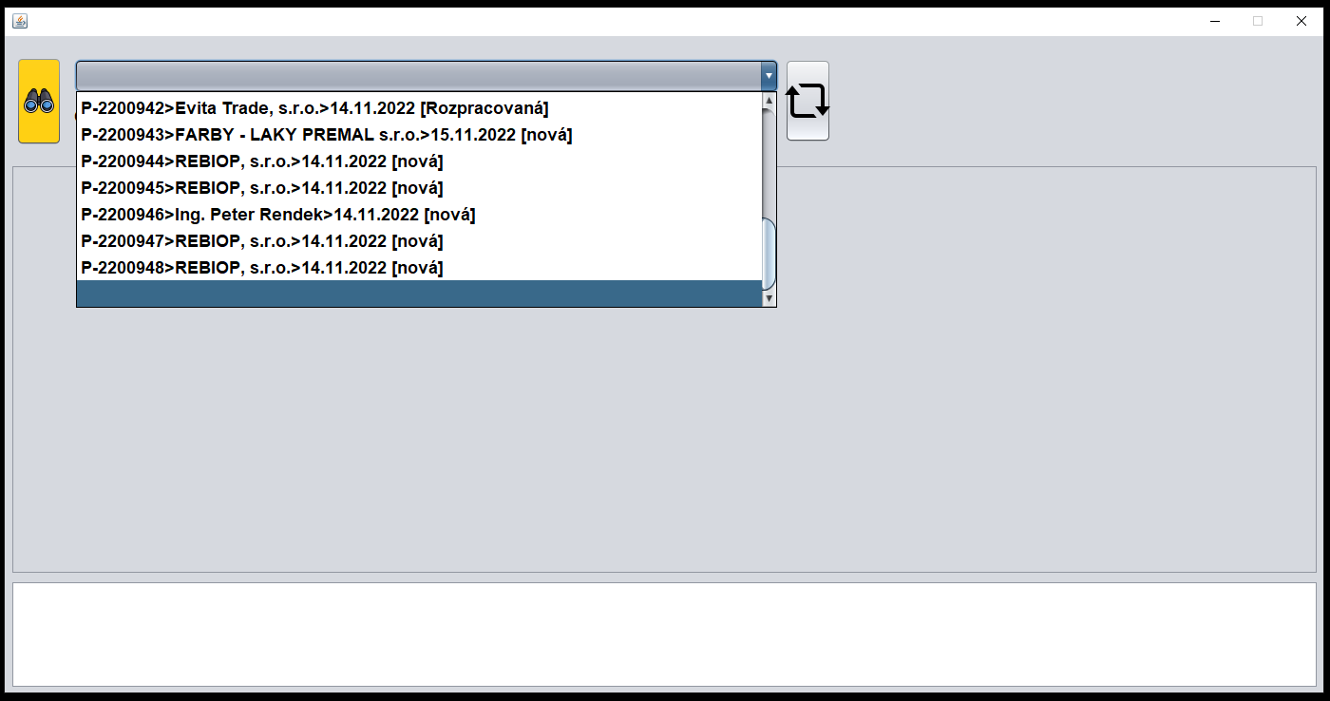

Slide 19
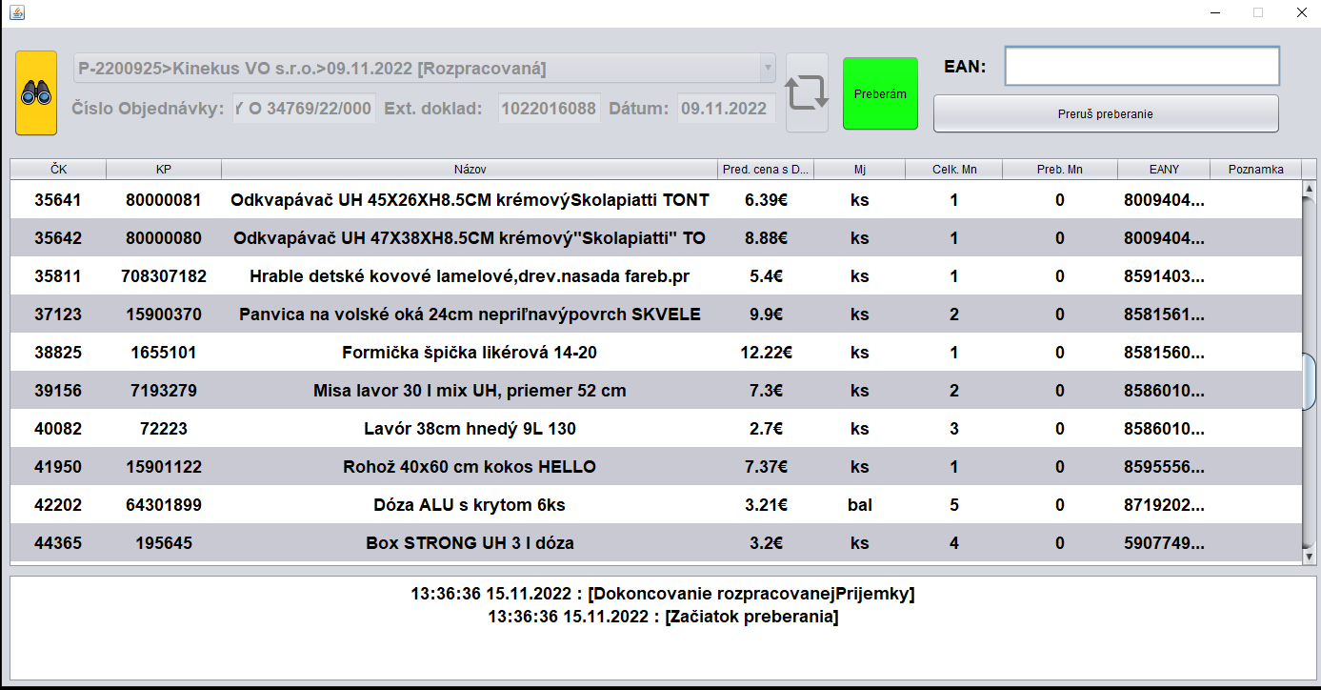

Slide 20
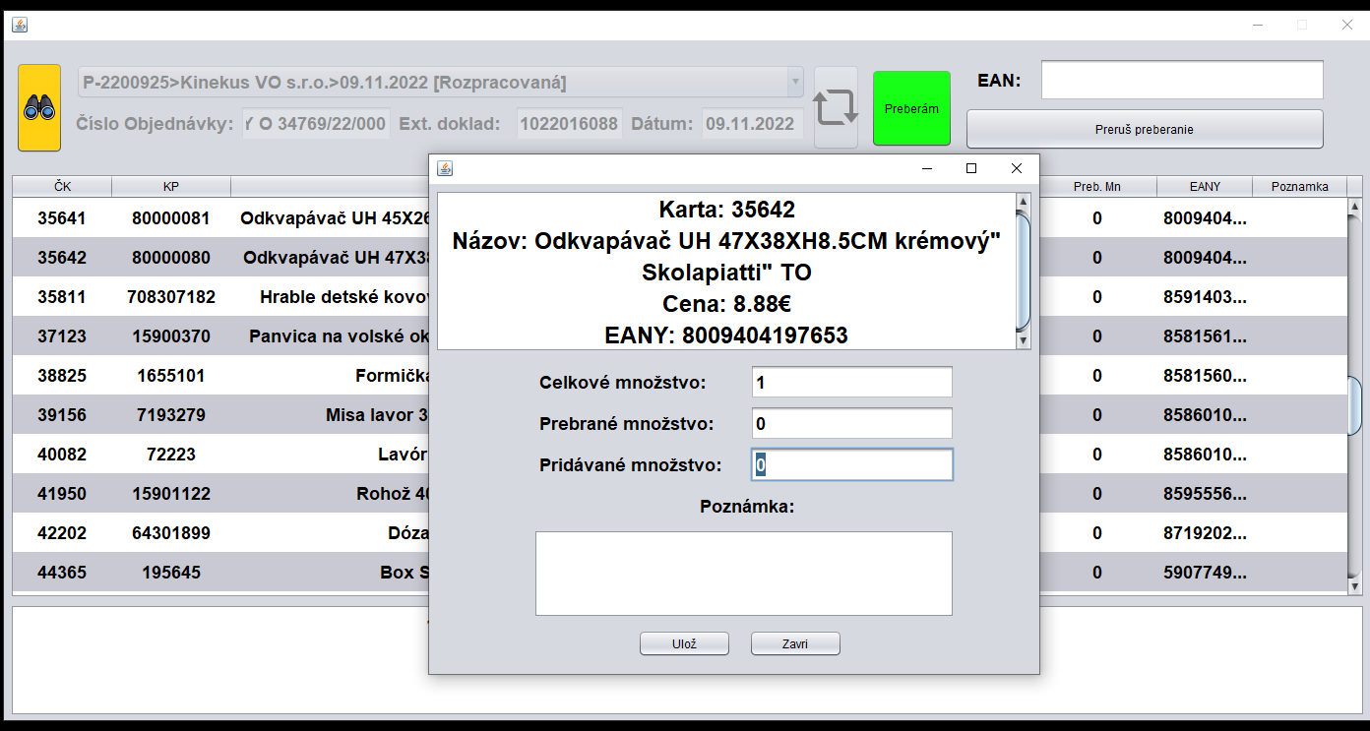

Slide 21
